Slide 1
DQR : A Probabilistic Approach to Diversified Query recommendation
Date: 2013/05/20
Author: Ruirui Li, Ben Kao, Bin Bi, Reynold Cheng,
Eric Lo
Source: CIKM "12
Advisor: Jia-ling, Koh
Speaker: Jiun Jia, Chiou

Slide 2
Outline
Introduction
The DQR Approach
Concept Mining
Query Recommendation
Experiment
Conclusion

Slide 3
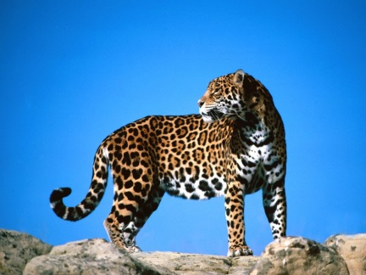
Introduction
The effectiveness of keyword-based search engines, depends largely on the ability of a user to formulate proper queries that are both expressive and selective.
Jaguar
ambiguous
Short &
not specific
Disney
Theme Parks |  | Stores |  | Cartoon characters on the film-making studios
Notes:
An expressive query clearly and unambiguously describes a user’s search intent, while a selective query results in a relatively small set of matching documents. Properly formulated queries bring users directly to the desired information

Slide 4
Introduction
Web search queries issued by casual users are often short and with limited expressiveness.
Traditional similarity-based methods often result in redundant and monotonic recommendations
Help users refine their queries
Query recommendation
Diversified
Redundancy
free
Notes:
Query recommendation is a popular technique employed by search engines to help users refine their queries.

Slide 5
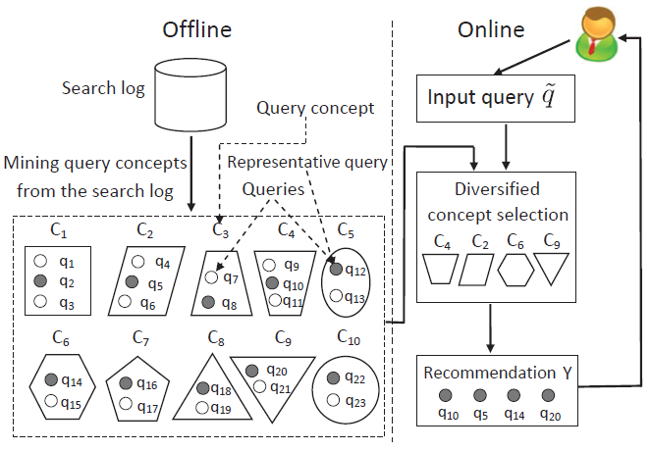
The DQR framework

Slide 6
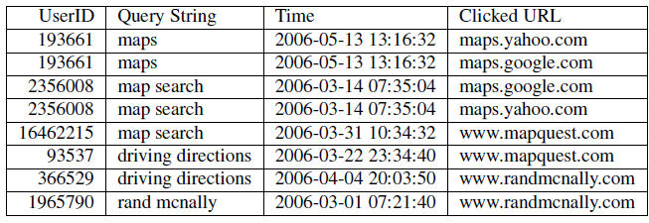
Sample AOL search log records
(1) It clusters search log queries to extract query concepts, based on which recommended queries are
selected.
(2) It employs a probabilistic model and a algorithm to achieve recommendation diversification.
Relevance
Diversity
Efficiency
Redundancy Free
Ranking

Slide 7
Outline
Introduction
The DQR Approach
Concept Mining
Query Recommendation
Experiment
Conclusion

Slide 8
DQR Approach-Concept Mining
Using a similarity measure to cluster queries, and use the set of URLs as the features of queries.
user-frequency-inverse-query-frequency
(UF-IQF)
: the number of unique users who have issued query q_{i}
and subsequently clicked URL d_{j}
: the number of queries that led to the clicking of URL d_{j}

Slide 9
|Q|=3 , |D|=3 in search log
User ID | Query | Clicked URL
001 | q1 | d1
002 | q1 | d2
003 | q1 | d1
004 | q2 | d2
005 | q2 | d1
006 | q2 | d3
007 | q3 | d3
Normalized
w(q1,d1) = 2*log(3/2) = 3.16
w(q1,d2) = 1*log(3/2) = 1.58
w(q1,d3) = 0
Feature vector : < 3.16 , 1.58 , 0 >
Feature vector : < 0.66 , 0.33 , 0 >
w(q2,d1) = 1*log(3/2) = 1.58
w(q2,d2) = 1*log(3/2) = 1.58
w(q2,d3) = 1*log(3/2) = 1.58
Feature vector : < 1.58 , 1.58 , 1.58 >
Feature vector : < 0.33 , 0.33 , 0.33 >

Slide 10
q1 Feature vector : < 0.66 , 0.33 , 0 >
q2 Feature vector : < 0.33 , 0.33 , 0.33 >
d( q1,q2 )= = 0.467
$$\sqrt{\text{(0.66−0.33)}\text{2} \text{+(0.33−0.33)}\text{2 }\text{ +(0−0.33)}\text{2}}$$
s( q1,q2 ) = 1- 0.467/$\sqrt{2}$ = 0.67

Slide 11
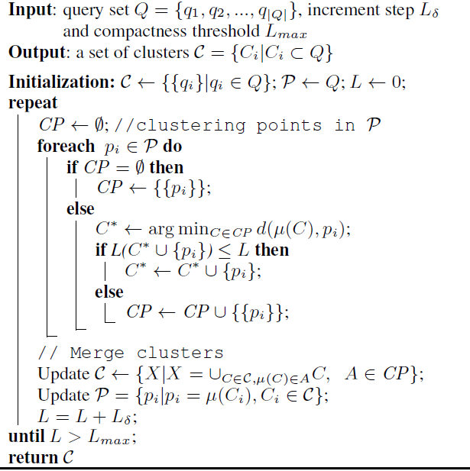

Slide 12
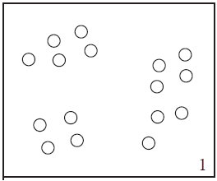
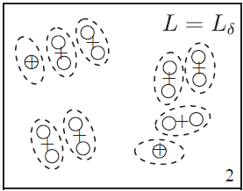
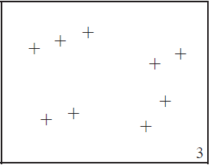
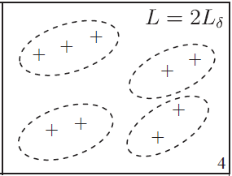
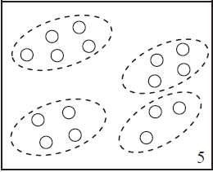
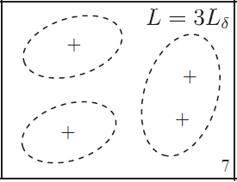
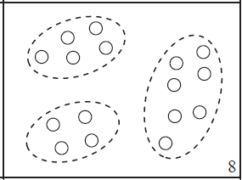

Slide 13
Outline
Introduction
The DQR Approach
Concept Mining
Query Recommendation
Experiment
Conclusion

Slide 14
DQR Approach-Query Recommendation
A user issues a query q to a search engine, he/she may click a set of URLs, s, returned by the search engine.
They use I: q → s to denote such an interaction, which is captured by a set of records in the search log.
Query(Q) : | q1: maps | q2: map search | q3: driving directions | q4: rand mcnally
Click sets(CS) : | s1: maps.yahoo.com , maps.google.com | s2: www.mapquest.com | s3: www.randomcnally.com
Interactions(I): | q1→ s1 | q2→ s1 | q2→ s2 | q3→ s2 | q2→ s3 | q4→ s3

Slide 15
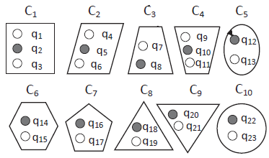
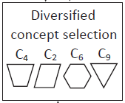
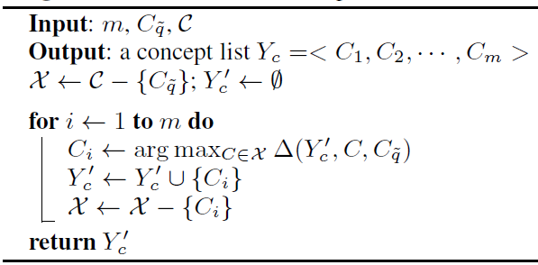
[ Concept Selection ]
Input query
Diversified Concept Recommendation

Slide 16
C1
C2
C3
q1
q2
q3
q4
q5
q6
q7
Assume: Query: q4 , CS={s1,s2,s3}
Query | Clicked URL
q1 | s1
q1 | s2
q2 | s1
q2 | s3
q3 | s1
q3 | s2
q3 | s2
q3 | s3
Query | Clicked URL
q4 | s1
q4 | s2
q4 | s2
q4 | s3
q5 | s2
q5 | s3
Query | Clicked URL
q6 | s1
q6 | s1
q6 | s2
q6 | s3
q6 | s3
q7 | s2
q7 | s3
q7 | s3
q7 | s3
s1: $\frac{1}{6}$
s2: $\frac{3}{6}$
s3: $\frac{2}{6}$
Notes:
NI(C˜q) : the number of interactions that involve some query of the cluster C ˜q
※ 假定各紀錄都為不同使用者

Slide 17
17
C1
C2
C3
q1
q2
q3
q4
q5
q6
q7
Assume: Query: q4 , CS={s1,s2,s3}
Query | Clicked URL
q1 | s1
q1 | s2
q2 | s1
q2 | s3
q3 | s1
q3 | s2
q3 | s2
q3 | s3
Query | Clicked URL
q4 | s1
q4 | s2
q4 | s2
q4 | s3
q5 | s2
q5 | s3
Query | Clicked URL
q6 | s1
q6 | s1
q6 | s2
q6 | s3
q6 | s3
q7 | s2
q7 | s3
q7 | s3
q7 | s3
Yc’
C2
s1: $\frac{1}{6}$
1- $\frac{1}{6}$ = $\frac{5}{6}$
s2: $\frac{3}{8}$
1- $\frac{3}{8}$ = $\frac{5}{8}$
s3: $\frac{2}{9}$
1- $\frac{2}{9}$ = $\frac{7}{9}$

Slide 18
18
C1
C2
C3
q1
q2
q3
q4
q5
q6
q7
Assume: Query: q4 , CS={s1,s2,s3}
Query | Clicked URL
q1 | s1
q1 | s2
q2 | s1
q2 | s3
q3 | s1
q3 | s2
q3 | s2
q3 | s3
Query | Clicked URL
q4 | s1
q4 | s2
q4 | s2
q4 | s3
q5 | s2
q5 | s3
Query | Clicked URL
q6 | s1
q6 | s1
q6 | s2
q6 | s3
q6 | s3
q7 | s2
q7 | s3
q7 | s3
q7 | s3
Yc’
C2
s1: $\frac{3}{6}$
s2: $\frac{3}{8}$
s1: $\frac{2}{9}$

Slide 19
19
C1
C2
C3
q1
q2
q3
q4
q5
q6
q7
Assume: Query: q4 , CS={s1,s2,s3}
Query | Clicked URL
q1 | s1
q1 | s2
q2 | s1
q2 | s3
q3 | s1
q3 | s2
q3 | s2
q3 | s3
Query | Clicked URL
q4 | s1
q4 | s2
q4 | s2
q4 | s3
q5 | s2
q5 | s3
Query | Clicked URL
q6 | s1
q6 | s2
q6 | s2
q6 | s3
q6 | s2
q7 | s2
q7 | s3
q7 | s3
q7 | s3
Yc’
C2
s1: $\frac{1}{6}$
s2: $\frac{4}{8}$
s1: $\frac{4}{9}$

Slide 20
20
Yc’
Yc’
C2
C2
C1
s1: $\frac{1}{6}$ * $\frac{3}{6}$ * (1- $\frac{1}{6}$ ) = 0.0694
s2: $\frac{3}{6}$ * $\frac{3}{8}$ * (1- $\frac{3}{8}$ ) = 0.1172
0.0694+0.1172+0.0576
= 0.2442
s3: $\frac{2}{6}$ * $\frac{2}{9}$ * (1- $\frac{2}{9}$ ) = 0.0576
Yc’
Yc’
C2
C2
C3
s1: $\frac{1}{6}$ * $\frac{1}{6}$ * (1- $\frac{1}{6}$ ) = 0.0231
s2: $\frac{3}{6}$ * $\frac{4}{8}$ * (1- $\frac{3}{8}$ ) = 0.1563
0.0231+0.1563+0.1152
= 0.2946
s3: $\frac{2}{6}$ * $\frac{4}{9}$ * (1- $\frac{2}{9}$ ) = 0.1152

Slide 21
21
[ Pick one representative query from each concept ]
C₄
C₂
C₆
C₉
UserID | Query | Clicked URL
001 | q4 | s1
002 | q5 | s2
003 | q5 | s2
004 | q6 | s3
005 | q4 | s1
006 | q5 | s3
q4 : 1
q5 : 3
q6 : 2

Slide 22
Outline
Introduction
The DQR Approach
Concept Mining
Query Recommendation
Experiment
Conclusion

Slide 23
Experiment
Data Sets :
AOL ─ search log
SOGOU ─ search log of Chinese search engine
Removing non-alpha-numerical characters from query strings.
Removing redundant space characters.
Removing queries that appear only once in the search log.

Slide 24
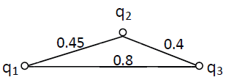
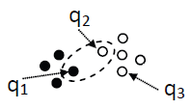
Experiment
compactness requirement: “ pairwise distance of queries in a cluster ≤ 0.5”.

Slide 25
Experiment
Part 1 :Comparing different recommendation methods – recommendation lists for
the query “yahoo” using the AOL dataset.
some
Typo queries
Typo queries
Similarity-based recommender(SR) : Relevant but Redundant
Maximal Marginal Relevance(MMR) : Diverse but Redundant
DQR-ND(No Diversity) and DQR : Redundancy-free
Context-Aware Concept-Based(CACB) : not match the user’s search intent (“yahoo”)
Notes:
§ Recall that CACB’s objective is to predict a user’s next query, the recommendation it makes does not necessarily has to be relevant to the user’s input query.

Slide 26
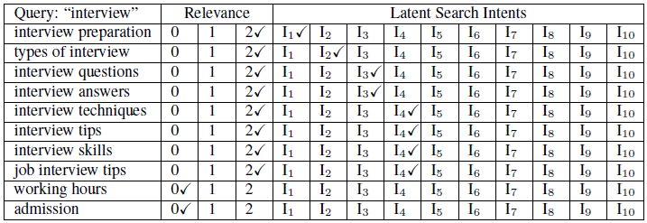
Experiment
Part 2 : Evaluate the performances of the recommendation methods
12 people to judge the recommendations given by the six methods
Select 60 test queries from the AOL search log
Evaluation form:

Slide 27
Relevancy Performance
N_{1,2} : the average number of partially relevant or relevant recommended queries in an evaluation.
S_{1,2} : the average score of non-irrelevant recommended queries.
S_{0,1,2} : the average score of all the recommended queries.

Slide 28
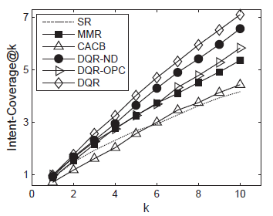
Diversity Performance
Define : Intent-Coverage@k ( IC@k )
number of search intents so identified among the top k recommended queries
on an evaluation form.

Slide 29
Ranking Performance
Two Ranking Measure:
Normalized Discounted Cumulative Gain (NDCG)
Mean Reciprocal Rank (MRR)
Recommendation query
rq1
rq2
rq3
rq4
rq5
rq6
rq7
rq8
rel
irrel
rel
partial_rel
irrel
rel
irrel
irrel
2
0
2
1
0
2
0
0
NDCG@5 = $\frac{2^{2}−1}{log⁡(1+1)}$ +0+ $\frac{2^{2}−1}{log⁡(3+1)}$ + $\frac{2^{1}−1}{log⁡(4+1)}$ +0
MRR@5 = $\frac{1}{1}$+ $\frac{1}{3}$ + $\frac{1}{4}$ + $\frac{1}{6}$ + 0

Slide 30
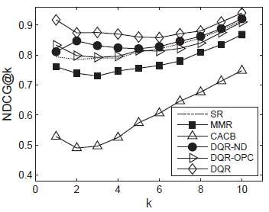
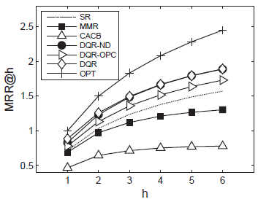
Experiment

Slide 31
Outline
Introduction
The DQR Approach
Concept Mining
Query Recommendation
Experiment
Conclusion

Slide 32
Conclusion
In this paper , they investigated the problem of recommending queries to better capture the search intents of search engine users.
Five important requirements of a query recommendation
Relevancy
Redundancy-free
Diversity
Ranking-performance
Efficiency
Through a comprehensive user study, they showed that DQR performed very well.

